Slide 1

UNIT 4
BACKTRACKING
Branch-And-Bound
(Reference Book - Horowithz Sahni)
Notes:
1
1

Slide 2
2
Basic Concepts
Live Node
A node which has been generated and all of whose children have not yet been generated is called a live node.
E-node
The live node whose children are currently being generated is called the E-node.
Dead Node
A generated node which is not to be expanded further or all of whose children have been generated is called a dead node.
Bounding function
It is used to kill live nodes without generating all their children.
Notes:
2

Slide 3
3
Backtracking
Outline
General method
Recursive backtracking algorithm
Iterative backtracking method.
8-Queen problem
Hamiltonian Cycle
0/1 Knapsack Problem
Notes:
3

Slide 4
4
Backtracking Algorithm
Based on depth-first recursive search
Approach
Tests whether solution has been found
If found solution, return it
Else for each choice that can be made
Make that choice
Recur
If recursion returns a solution, return it
If no choices remain, return failure
Some times called “search tree”
Notes:
4

Slide 5
5
Recursive backtracking algorithm
Initially invoked by Backtrack(1)
T(x₁,x₂,…,x_{i}): set of all possible values for x_{i+1} such that (x₁,x₂,…,x_{i},x_{i+1}) is also a path to a problem state
B_{i+1}(x₁,x₂,…,x_{i},x_{i+1}): bounding function
If B_{i+1}(x₁,x₂,…,x_{i},x_{i+1}) is false, then the path cannot be extended to reach an answer node
void Backtrack( int k )
// This is a schema that describes the backtracking process using
//recursion. On entering, the first k-1 values x[1], x[2], …., x[k-1] of the
//solution vector x[1:n] have been assigned. x[] and n are global.
{
for (each x[k] such that x[k] ∈ T(x[1], …, x[k-1]) {
if (B_{k} (x[1], x[2], …, x[k])) {
if (x[1], x[2], …, x[k] is a path to an answer node)
output x[1:k];
if (k < n) Backtrack(k+1);
}
}
}
Notes:
5

Slide 6
6
Iterative backtracking method
void IBacktrack( int n )
// This is a schema that describes the backtracking
//process. All solutions are generated in x[1:n] and printed
// as soon as they are determined.
{
int k=1;
while (k) {
if (there remains an untried x[k] such that x[k] is in
T( x[1], x[2], …, x[k-1] ) and
B_{k}(x[1], …,x[k]) is true) {
if ( x[1], …, x[k] is a path to an answer node )
output x[1:k];
k++; // Consider the next set.
}
else k--; // Backtrack to the previous set.
}
}
Notes:
6

Slide 7
7
Example: The n-Queen problem
Place n queens on an n by n chess board so that no two of them are on the same row, column, or diagonal
Notes:
7

Slide 8
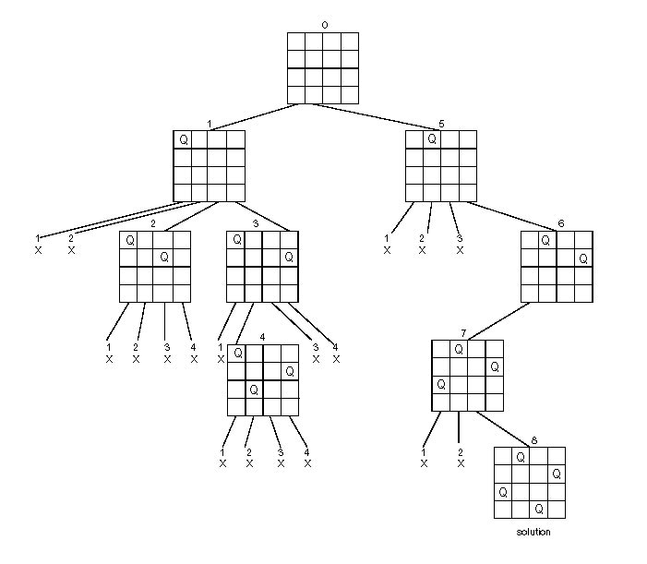
8
State Space Tree of the Four-queens Problem
Notes:
8

Slide 9
9
Algorithm – The n-queen problem
Plac(k, i)
{
for j = 1 to k - 1 do
if((x[j] = i) or (Abs(x[j] – i) = Abs(j - k )))
return false;
return true;
}
NQueen(k, n)
{
for i = 1 to n do{
if Place(k, i) then{
x[k] = i;
if (k = n) then write (x[1:n]);
else Nqueen(k+1, n);
}
}
}
Notes:
9

Slide 10
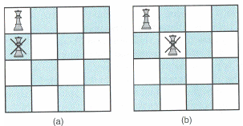
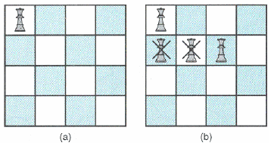
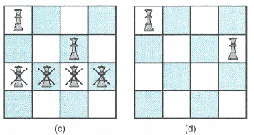
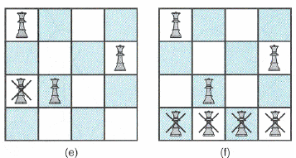
10
Example
Notes:
10

Slide 11
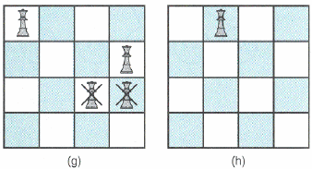
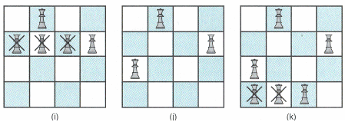
11
Continued…
Notes:
11

Slide 12
12
Hamiltonian Cycles
Definitions
Hamiltonian cycle (HC): is a cycle which passes once and exactly once through every vertex of G and returns to starting position
Hamiltonian path: is a path which passes once and exactly once through every vertex of G (G can be digraph).
A graph is Hamiltonian iff a Hamiltonian cycle (HC) exists.
Notes:
12

Slide 13
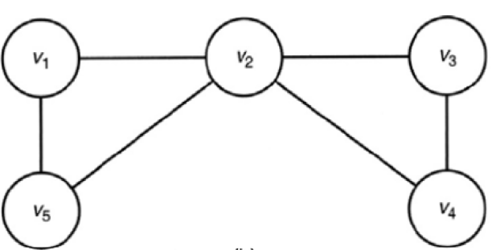
13
The Hamiltonian Circuits Problem
Hamiltonian Circuit
[v1, v2, v8, v7, v6, v5, v4, v3, v1]
v1
v2
v3
v4
v8
v7
v6
v5
No Hamiltonian Circuit
Notes:
13

Slide 14
14
Algorithm
X[1: k-1] is a path of k-1 distinct vertices if x[k]=0, then no vertex has as yet been
assigned to x[k]. After execution x[k] is assigned to the next highest number vertex
which does not already appear in x[1, k-1] & is connected by an edge to x[k-1]. otherwise x[k] =0, if k=n then in addition x[k] is connected to x[1].
Algorithm Nextvalue(k) {
repeat {
x[k] := (x [k] + 1) mod (n + 1) //next vertex
If ( x[k] = 0) then return
If G[x[k – 1], x[k]] ≠ 0 ) then { //Is there an edge?
for j = 1 to k – 1 do if (x[j] = x[k]) then break;
//check distinctness
If ( j = k) then //if true then vertex is distinct
If (( k < n ) or (( k = n) and G [x[n] , x[1] ≠ 0))
then return
}
} until ( false) ;
}
1
2
4
3
Next
Notes:
14

Slide 15
15
Continued…
This algorithm uses the recursive formulation of backtracking to find all the hamiltonion cycles of a graph. The graph is stored as an adjacency matrix G[1:n, 1:n]. All cycles begins at node 1.
Algorithm Hamiltonian(k)
{
repeat {
//generate values for x[k]
Nextvalue (k); //assign a legal next value to x[k]
if ( x[k] = 0 ) then return
if (k = n) then write ( x[1 : n]);
else Hamiltonian(k + 1);
} until(false);
}
//Set x[2:n] to zero and x[1] to 1. Execute Hamiltonian(2).
Notes:
15

Slide 16
16
Application
Hamiltonian cycles in fault random geometric network
In a network, if Hamiltonian cycles exist, the fault tolerance is better.
Notes:
16

Slide 17
17
Knapsack backtracking
We are given n objects and a knapsack or bag. The objective is to obtain a filling of the knapsack that maximizes the total profit earned.
Given
n = number of weights
w = weights
P =profits m= knapsack capacity
Using greedy approach Choosing a subset of the weights such that
Max Σ_{1≤i ≤n} p_{i}x_{i} subject to Σ_{1≤i ≤ n} w_{i}x_{i} ≤ m
0 ≤ x_{i} ≤ 1 1 ≤ i ≤ n
Notes:
17

Slide 18
18
The backtracking method
A given problem has a set of constraints and possibly an objective function.
The solution must be feasible and it may optimize an objective function.
We can represent the solution space for the problem using a state space tree
The root of the tree represents 0 choice,
Nodes at depth 1 represent first choice
Nodes at depth 2 represent the second choice, etc.
In this tree a path from a root to a leaf represents a candidate solution
Notes:
18

Slide 19
19
Continued…
Definition: We call a node nonpromising if it cannot lead to a feasible (or optimal) solution, otherwise it is promising.
Main idea: Backtracking consists of doing a DFS of the state space tree, checking whether each node is promising and if the node is nonpromising backtracking to the node’s parent.
Notes:
19

Slide 20
20
Backtracking solution to the 0/1 knapsack problem (// initial fp = -1 and Bknap (1,0,0) )
Algorithm Bknap( k, cp, cw) {
If ( cw + w[k] ≤ m) then // generate left child then {
y[k] := 1
If ( k < n) then Bknap(k + 1, cp + p[k], cw + w[k]);
If (( cp + p[k] > fp ) and (k = n) then {
fp := cp + p[k]; fw := cw + w[k];
for j := 1 to k do x[ j ] := y[ j ];
}
}
If(bound (cp, cw ,k) ≥ fp ) then //generate right child {
y[k] := 0; if ( k < n) then Bknap( k + 1, cp, cw);
If (( cp > fp ) and ( k = n )) then {
fp := cp; fw := cw;
for j := 1 to k do x[ j ] := y[ j ]
}
}
}
Notes:
20

Slide 21
21
Continued…
Algorithm bound( cp, cw, k)
//cp is the current profit, cw is the current wt total, k is the index of last removed item and m is the knapsack size
{
b := cp; c := cw;
for i := k + 1 to n do {
c := c + w[i];
if ( c < m) then b := b + p[i] ;
else return b + (1 - (c - m)/ w[i]) * p[i];
}
return b;
}
Back
Notes:
21

Slide 22
22
Example
Suppose n = 4, W = 16, and we have the following:
i pi wi pi / wi
1 $40 2 $20
2 $30 5 $6
3 $50 10 $5
4 $10 5 $2
Notes:
22

Slide 23
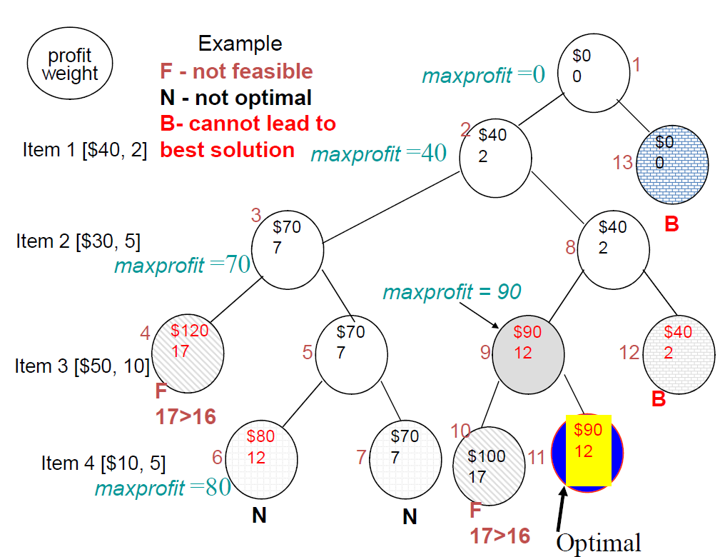
23
Notes:
23

Slide 24
24
Worst-case time complexity
Check number of nodes:
1 + 2 + 2² + 2³ + … + 2^{n} = 2^{n+1} – 1
Time complexity:
O(2^{n})
Notes:
24

